Slide 1

Break-even Analysis for
Swift Drink
Sebestian | laurie | leida | milfort | ardon

Slide 2
OBJECTIVE
Ana,
You already know why we’re stepping forward — I want to win your special prize and secure your matching donation for Relief Aid in the amount of $2,735.22, which represents our projected annual net profit.
But more importantly, we’re excited about what that number represents.
Your goal isn’t just to raise money — it’s to raise as much as possible while involving as many neighbors as possible. That’s what motivates us most. This isn’t about a single donation. It’s about mobilizing the entire neighborhood.
My plan is simple:
Personally engage households rather than relying only on messages or flyers
Encourage small but meaningful contributions so more neighbors can participate
Create friendly momentum by sharing progress updates to keep everyone energized
Make participation feel collective — not transactional
If we raise $2,735.22, your matching gift would immediately double that impact to $5,470.44 for Relief Aid. And if we involve dozens of neighbors in reaching that number, the true impact becomes even bigger than the dollars alone — it builds community ownership around generosity.
We’re genuinely enthusiastic about this challenge. We don’t just want to reach the target — we want to rally the neighborhood around it.
Thank you for creating an opportunity that turns fundraising into community building. We’re ready to get started.
— Team Swift

Slide 3
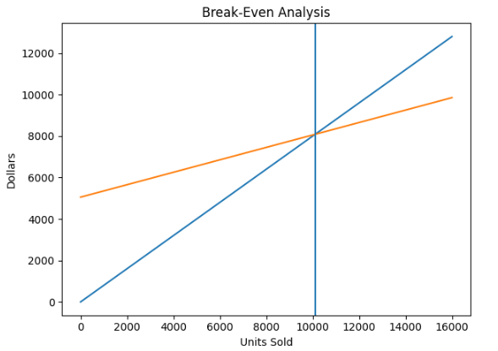
DATA
Annual Fixed Costs – $5,053.68
Costs that remain constant regardless of sales
Includes rent, utilities, and overhead
Must be covered before profit begins
Variable Cost per Cup – $0.30
Cost that increases with each cup sold
Includes ingredients and packaging
Directly impacts profit per unit
Price & Percent of Demand – $0.80 per Cup
Revenue earned per cup sold
Balanced to maintain strong demand
Contribution margin: $0.50 per cup
Break-Even Point – 10,107 Cups
Sales level where revenue equals total cost
No profit, no loss at this point
Sales above this generate profit
Annual Net Profit – $2,735.22
Profit after covering all costs
Achieved by selling 15,577 cups
Indicates strong financial performance
Revenue Line – This upward-sloping line shows how total revenue increases as more cups are sold. It is calculated as price × quantity. Since the price is $0.80 per cup, revenue increases steadily with each additional sale.
Total Cost Line – This line starts above zero at the annual fixed cost of $5,053.68 and increases as more cups are sold. It reflects both fixed costs and variable costs ($0.30 per cup).
Break-Even Point (Intersection) – The point where the revenue and total cost lines cross represents 10,107 cups. At this level, total revenue equals total cost. To the left is a loss; to the right is profit.

Slide 4
Persuasion
Ana,
We were reviewing our projected annual net profit, and it’s sitting at $2,735.22 for the year. That’s not just a random number — it represents disciplined planning, consistent performance, and staying above my break-even point all year.
What excites us most is that this profit didn’t happen by accident. It came from structured goals, steady growth, and pushing past the minimum requirement. If we can clear that margin, we honestly believe you can match it — or even exceed it.
Think about it this way: matching $2,735.22 over a year breaks down to about $228 per month. When you look at it monthly, it feels much more achievable. With focused effort, small strategic adjustments, and consistency, that target is very realistic.
Let’s make it a challenge — we’ve set the benchmark. Now match it.
We know you can.

Slide 5
Conclusion
In closing, this drink business model shows that with clear cost control, strategic pricing, and strong community demand, we can not only operate above our break-even point but generate meaningful net profit. That projected annual net profit of $2,735.22 is more than just a number — it represents disciplined planning, consistent performance, and the ability to mobilize support effectively.
By applying that same focus and enthusiasm to our Relief Aid fundraising effort, I am confident we can reach — and potentially exceed — that target. With your matching contribution, we could double the impact and significantly increase the support delivered to those in need.
Thank you sincerely for your time, your leadership, and your commitment to raising as much as possible for Relief Aid. We truly appreciate the opportunity to present and to be part of this meaningful initiative.

